Slide 1
Asking the Right Questions About What We Do WCET Annual Meeting
November 2, 2012

Slide 2
Methodology
Partnered with Campus Computing.
Respondents from all higher education sectors across the US.
Target senior online learning person.
Conducted in late 2011.
N=199

Slide 3
Our efforts to expand our online education programs have been impeded by the following ( pct agree/strongly agree):

Slide 4
Our efforts to expand our online education programs have been impeded by the following ( pct agree/strongly agree):
1. Demand exceeds capacity 60%
1. Federal regulations 60%

Slide 5
Our efforts to expand our online education programs have been impeded by the following ( pct agree/strongly agree):
3. Faculty resistance 53%
Budget cuts 60%
Lack key resources 50%
State regulations 47%

Slide 6
Top issues confronting online education over the next two to three years (vote for two):
1. Org. challenges to tradition 28%
Improving retention 26%
Assuring the quality of instruction 25%

Slide 7
Top issues confronting online education over the next two to three years (vote for two):
Federal & sate regulations 23%
Responding to rising demand 21%

Slide 8
Do students in your online programs pay the same total tuition (not including special fees for books or course materials) as students in your on-campus programs?
All Institutions
No 36.5%
Yes 63.5%
Notes:
A word about the terms Tuition and Fees.
I use them separately, I noted that Fees is sometimes used to mean both.

Slide 9
Do students in your online programs pay the same total tuition (not including special fees for books or course materials) as students in your on-campus programs?
All Institutions
Public Universities
Responding ‘Yes’
By Highest Offering:
Doctoral – 56.5%
Masters – 53.8%
4-Year – 50.0%
Associates – 74.1%
No 36.5%
Yes 63.5%
Notes:
Doct 46
Masters 40
4-year 4
Assoc 54

Slide 10
If “no” to previous question… Compared to our on-campus courses and programs tuition/fees for one term in our online program are:
All Institutions
Charge LESS 19.3%
Charge MORE 80.7%
Notes:
This represents only 72 institutions

Slide 11
If “no” to previous question… Compared to our on-campus courses and programs tuition/fees for one term in our online program are:
$0 – $100 Less 4.8%
$101 – $250 Less 4.8%
Over $251 Less 9.6%
All Institutions
Over $251 More 21.7%
$0 – $100 More 33.7%
$101 – $250 More 25.3%

Slide 12
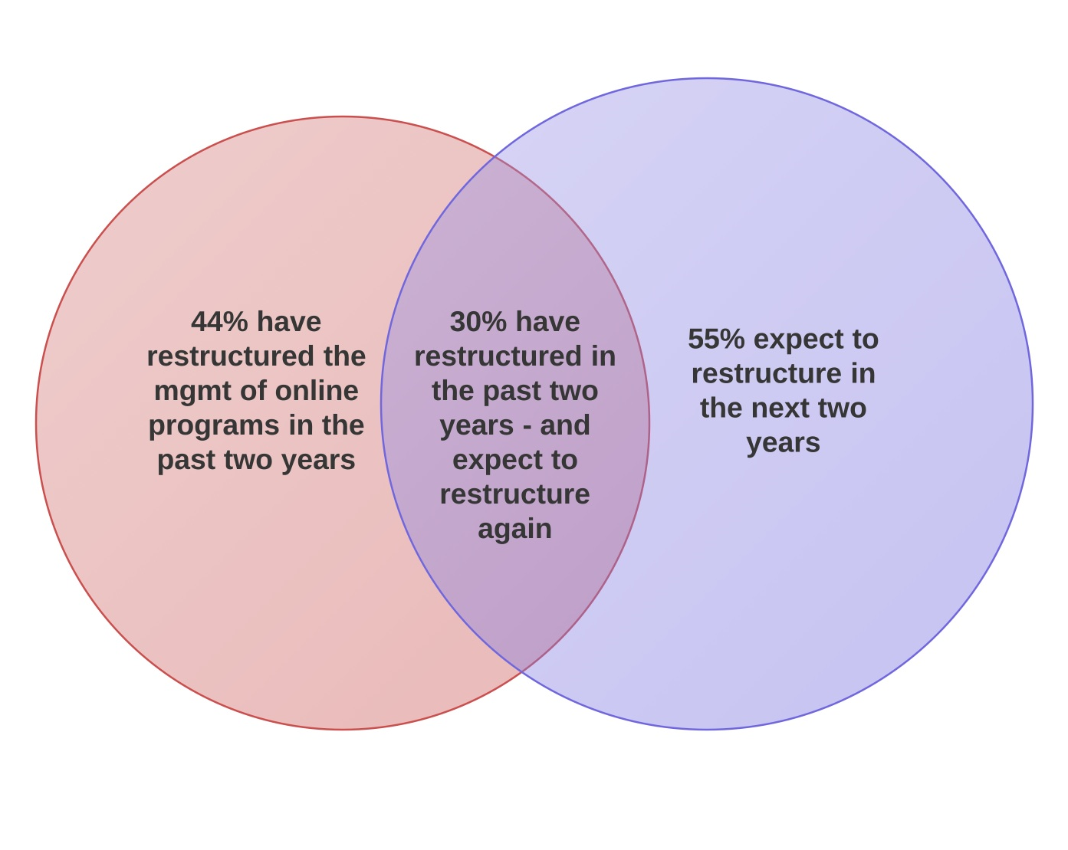
Reorganizing the Management of Online Education (WCET 2011)

Slide 13
Reorganizing the Management of Online Education (WCET 2011)
39%
have restructured
in last two years
49%
will likely restructure
in next two years

Slide 14
Reorganizing the Management of Online Education (WCET 2011)
39%
have restructured
in last two years
49%
will likely restructure
in next two years
23%
have restructured
and likely will again.

Slide 15
Factors contributing to the reorganization of the management of online programs at your campus?

Slide 16
Factors contributing to the reorganization of the management of online programs at your campus?
1. Budget issues 51%
Coordinating instructional resources 41%
Impact of program expansion 40%

Slide 17
Factors contributing to the reorganization of the management of online programs at your campus?
Change in institution leadership 36%
Change in online leadership 31%

Slide 18
Are the issues listed below significant sources of faculty resistance to teaching online (% significant/very significant)

Slide 19
Are the issues listed below significant sources of faculty resistance to teaching online (% significant/very significant)
1. More work for faculty 49%
Quality is less 33%
Student interaction insufficient 30%

Slide 20
Are the issues listed below significant sources of faculty resistance to teaching online (% significant/very significant)
Not familiar with technologies 29%
Insufficient compensation 24%
Not in faculty contract 19%

Slide 21
Limits for the number of students in individual online courses or class selections
 | Percent
Institutions that have limits | 69%
 | No. of Students
Average maximum number of students for online classes | 35

Slide 22
Availability of technical support services for students in online programs:
M–F / 9-5
12%
Around the clock
34%
M–F / 9-5
Limited evenings
20%
M–F / 9-5 Limited evenings
& weekends 35%

Slide 23
QUESTIONS????
Russ Poulin rpoulin@wiche.edu

